Slide 1
Why Must We Change?
Strategies For Libraries
Diane I. Hillmann
Metadata Management Associates LLC
Presentation for CEAL
Wednesday, March 25, 2015

Slide 2
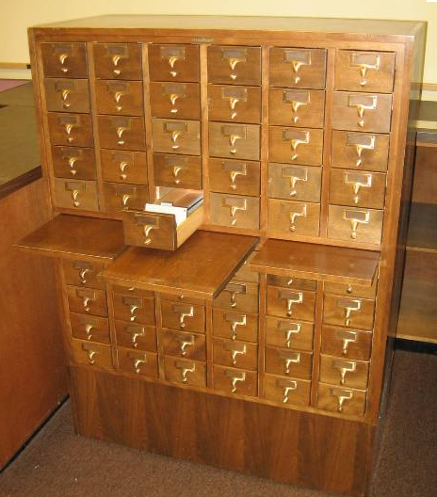
Questioning Our Metadata Ideas
Today’s metadata is not about choices of formats, it’s about ensuring interoperability and flexibility for our data sharing in the open world
Our old model is based on catalog cards, regardless of the newer methods of storage and delivery through our online catalogs
The new metadata environment provides better ways to express relationships—both content to content and concept to concept
Notes:
Interoperability is not dependent on common formats, common implementation decisions, or any other mandates we’ve stubbed our toes on in the past.

Slide 3
“Wikipedia is founded on the belief (largely correct, as it turns out) that crowds both can and will provide high-quality content and metadata to the world at no charge. For our part, in research libraries, we still tend to treat books as if they are primarily tools for linear reading, and metadata records as artisanal products. We still build collections that are fenced off from the larger information world and encourage our patrons, against all reason, to begin their information searches within the confines of our artificially limited collections.”
Rick Anderson, The Crisis in Research Librarianship,
Journal of Academic Librarianship, July 2011
Notes:
Rick Anderson is Associate Dean for Scholarly Resources & Collections at the University of Utah.

Slide 4
“We must look with cold and hard-headed rationality at our current practices and ask ourselves not what value they offer, but rather what value our patrons believe they offer. If what we offer our patrons is not perceived as valuable by them, then we have two choices: change their minds, or redirect our resources. The former is virtually impossible; the latter is enormously painful. But the latter is possible, and if we do not undertake such a redirection ourselves, it will almost certainly be undertaken for us.”
Rick Anderson, The Crisis in Research Librarianship,
Journal of Academic Librarianship, July 2011
Notes:
Assessment of value must take account of the age of the patron—younger ones tend not to be willing to learn about traditional practices and methods. The catalog is a great mystery to many of them.

Slide 5
“Today, we face another significant time of change that is being prompted by today’s library user. This user no longer visits the physical library as his primary source of information, but seeks and creates information while connected to the global computer network. The change that libraries will need to make in response must include the transformation of the library’s public catalog from a stand-alone database of bibliographic records to a highly hyperlinked data set that can interact with information resources on the World Wide Web. The library data can then be integrated into the virtual working spaces of the users served by the library.”
--Karen Coyle, Understanding the Semantic Web: Bibliographic Data and Metadata, Jan. 2010
Notes:
. Karen Coyle is an independent consultant and librarian who writes about libraries and metadata, and works in the area of new standards in the Semantic Web world. One of her publications "Understanding the Semantic Web” won the ALCTS Outstanding Publication Award. I mention that because it’s a terrific introduction to the ideas I’ll be discussing with you today

Slide 6
Questionable Assumptions?
We’re going to continue to build records for library catalogs
We’ve always shared ‘records’ in cataloging, and that’s still the right way to share data
The proliferation of metadata formats is a bad thing
The choice of the ‘right metadata format’ (e.g., DC, MODS, RDA, etc.) is critically important
The ‘old’ way of cataloging materials one-at-a-time always produces better quality data than any other method
Notes:
These tightly held beliefs are tremendous barriers to understanding where we need to go to accommodate (and celebrate) the opportunities we see before us.

Slide 7
Why Linked Open Data?
The current Web is primarily a Web of DOCUMENTS, where URLs embedded in documents link to other documents. The Semantic Web is a Web of DATA that exists outside of documents, and focuses on meaning or semantics
RDF is a general-purpose framework that provides structured, machine-understandable metadata for the Web
RDF Schemas (RDFS) and/or Web Ontology Language (OWL) describe the meaning of each property name
Metadata vocabularies can be developed and/or extended without central coordination

Slide 8
Model of ‘the World’ /XML
XML assumes a 'closed' world (domain), usually defined by a schema:
  "We know all of the data describing this resource. The single description must be a valid document according to our schema. The data must be valid.”
  XML's document model provides a neat equivalence to a metadata 'record’
Notes:
XML has its uses, and will continue to be useful in a number of ways. But it does not support linked data very well, and we can’t use it as the sole basis for moving forward.

Slide 9
Model of ‘the World’ /RDF
RDF assumes an 'open' world:
  "There's an infinite amount of unknown data describing this resource yet to be discovered. It will come from an infinite number of providers. There will be an infinite number of descriptions. Those descriptions must be consistent."
  RDF's statement-oriented data model has no notion of 'record’ (rather, statements can be aggregated for a fuller description of a resource)
Notes:
RDF is the language of the Web—it requires very different ways of thinking for us to manage.

Slide 10
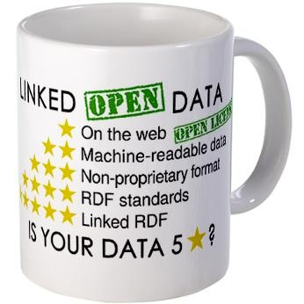
What is Linked Open Data?
”… a term used to describe a recommended best practice for exposing, sharing, and connecting pieces of data, information, and knowledge on the Semantic Web using URIs and RDF."
Notes:
These five ‘stars’ were developed by Tim Berners-Lee to describe his vision for a web of data.

Slide 11
Five Linked Data
Make your stuff available on the Web (whatever format) under an open license
Make it available as structured data (e.g. spreadsheet instead of an image scan of a table)
Use non-proprietary formats (e.g. CSV instead of Excel)
Use URIs to denote things, so that people can point at your stuff
Link your data to other data to provide context
Notes:
A fuller explanation of five star linked data (more than can be fit on a coffee cup

Slide 12
Subject
Predicate
Object
Austen, Jane
Pride and prejudice
is author of
[Subject]
[Subject]
has place of residence, etc.
has date of publication
Bath, UK
“1813”
[Object]
[Object]
Notes:
This is the human-friendly view, but the text-basis is not very helpful for machines.

Slide 13
Subject
Predicate
Object
http://rdaregistry.info/Elements/a/P50195
http://lccn.loc.gov/n79032879
http://worldcat.org/entity/work/id/3535
[Subject]
[Subject]
http://rdaregistry.info/Elements/a/P50109
http://rdaregistry.info/Elements/m/P30011
http://sws.geonames.org/2656173/
“1813”
[Object]
[Object]
Notes:
This is the machine-friendly view, all URIs except for the date.

Slide 14
Where do the identifiers in that picture come from?
LC NAF (Jane Austen)
RDA Registry (isAuthorOf)
Worldcat (Work identifier)
Bath, UK (Geonames)
Date is a ‘literal’, with no identifier (but could be explicitly ‘typed’ as a date)

Slide 15
Warning: Linked Data is Inherently Chaotic
Requires creating and aggregating data in a broader context
  There is no one ‘correct’ record to be made from this data, no objective ‘truth’, just multiple points of view
This approach is different from the cataloging tradition
  BUT, the focus on vocabularies is familiar
Linked data relies on the RDF model (although XML can be used to express RDF, it’s not always a happy marriage)
The bottom-up chaos and uncertainty of the linked data world is possibly the hardest thing for catalogers to get their heads around
Notes:
This is the scariest and least well understood part of linked data. But it’s essential to understand and accommodate this view. It’s why the notion of a master record and de-duping is often beside the point.

Slide 16
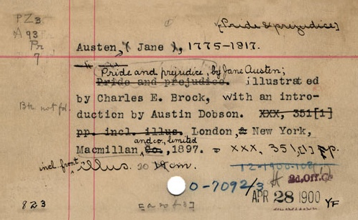
Let’s Look at Data
Keeping in mind the limitations of the catalog card above!

Slide 17
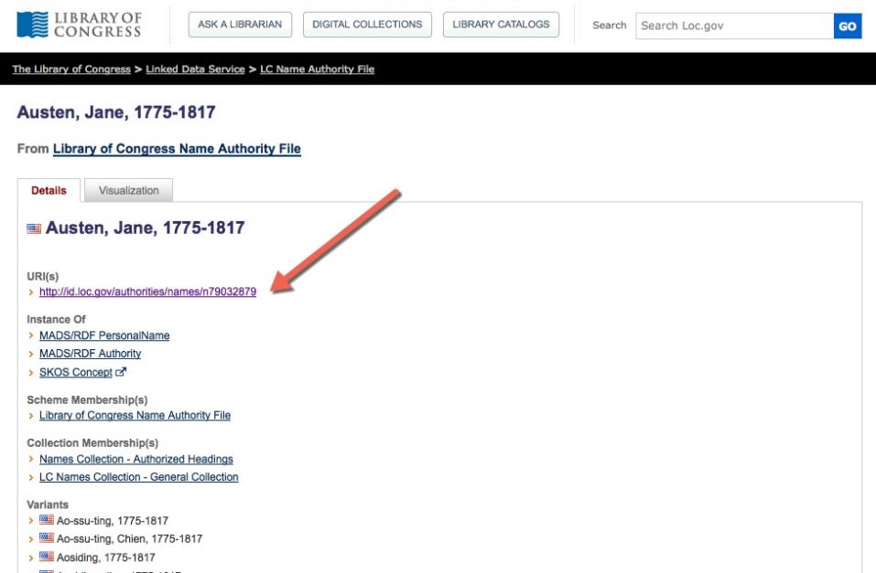
Notes:
The Library of Congress Linked data service, LC Name Authority File. This view is optimized for human readers, using text. At the end of the page you can see the list of other formats available by machine.

Slide 18
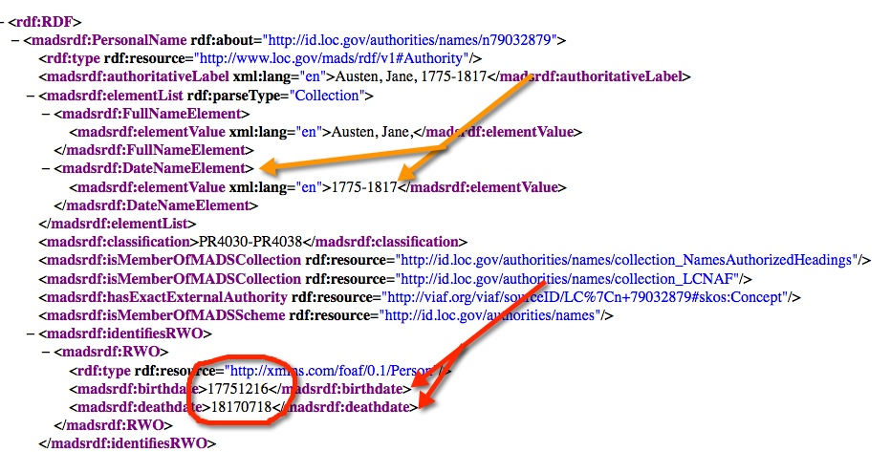
Notes:
This is the MADS/RDF machine-friendlier version of the previous human-friendly page. Note that the full name information and the date range correlate to the MARC authority heading, although the name and date information is separated (much as MARC already does with $d). Interestingly, the additional info with the red highlights is defined as FOAF Person information, which records the actually birthdate and death date as YYYYMMDD, just the way computers like it. Note that her 239th birthday is coming soon!

Slide 19
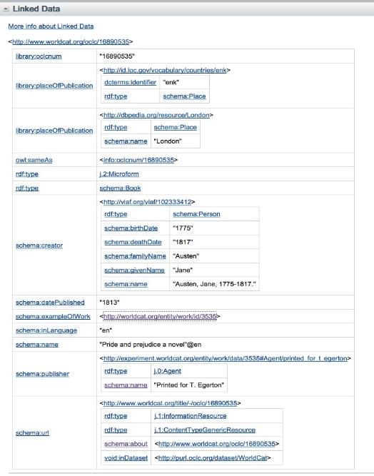
Notes:
This is the Work record for Pride and Prejudice. Sorry it’s impossible to see well on a slide. But I wanted to show how much data there is, in order to look closely later to see who’s data is being used or re-used. Note especially that there seems to be very little BibFrame or RDA data being used. What does that suggest to you?

Slide 20
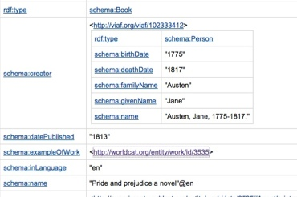
Jane Austen identifier information from VIAF
“Pride and prejudice” work identifier
Note that the ‘person’ portion is embedded from the VIAF files,
But the record itself is about “Pride and prejudice” and the display is created
by OCLC.
Notes:
A portion of the data on the previous page. Still not easy to see, but the JA info under her schema creator ‘box’ does not specifically identify her as an author—instead she is a ‘creator’ in schema.org terms

Slide 21
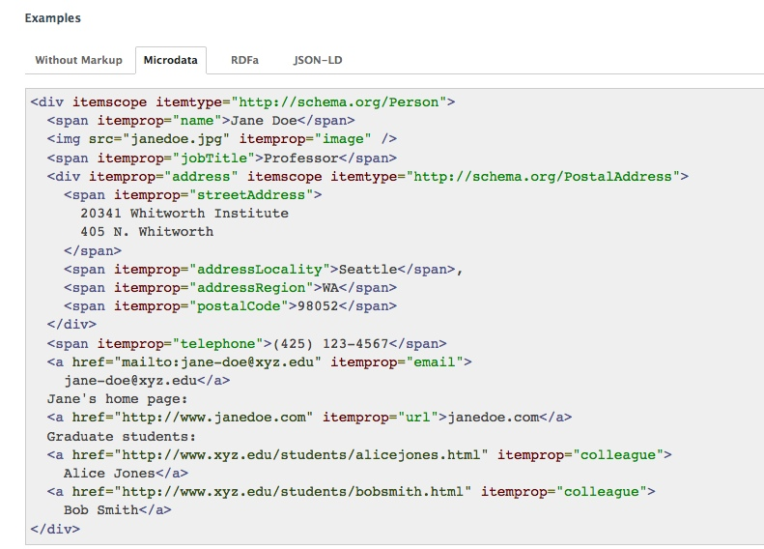
[Schema.org example for person]
Notes:
This is a sample showing the Microdata serialization for a schema.org person description. Note that for the most part, schema.org info is expected to be embedded in the resource to aid the search engines as they seek to discover resources on the web. This has important implications for maintenance of the data.

Slide 22
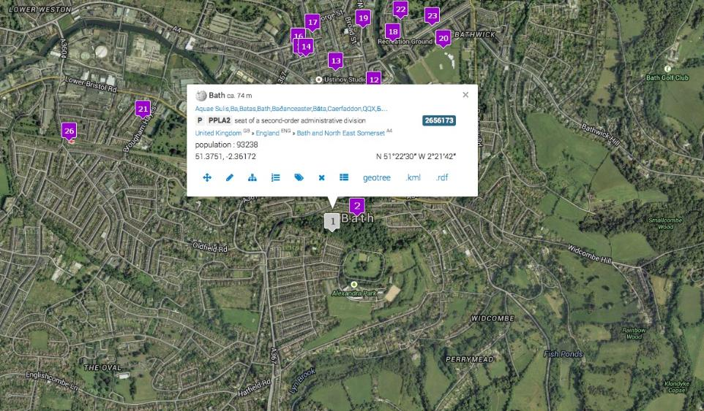
Map of Bath from Geonames
Notes:
This view is of a map of the area in England that includes Bath, with the selected metadata about Bath in the white box.

Slide 23
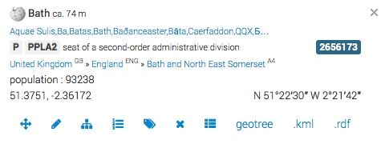
Alternative names
Place identifier in Geonames
Latitude & longitude
Geonames Map Key
Notes:
This is a larger view of that white box, called a map key by Geonames. Links and icons point out to other data or representations.

Slide 24
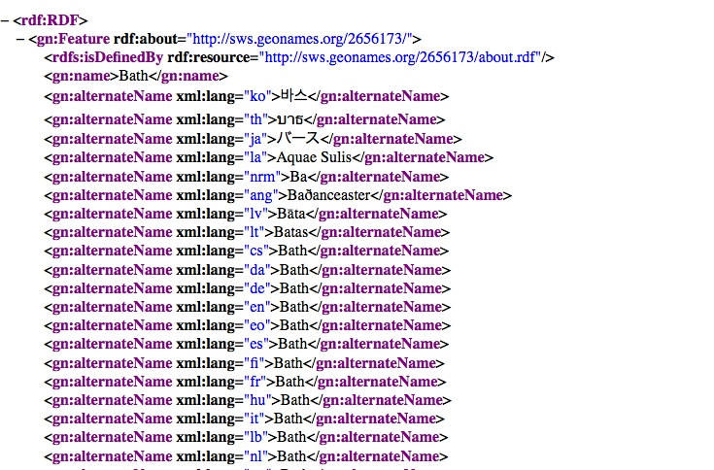
Notes:
Here is some of the coded detail from Geonames, showing alternate names in the data and the language source for each alternate. A local ‘gn’ namespace is used for the data.

Slide 25
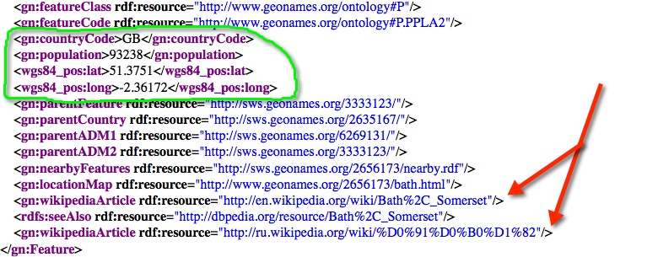
Notes:
Note that the ‘gn’ local set, including features, types of features, countryCodes (probably based on ISO codes). But the lat/long info uses a different namespace specifically for that data. The red arrows point out links to wikipedia and dbpedia.

Slide 26
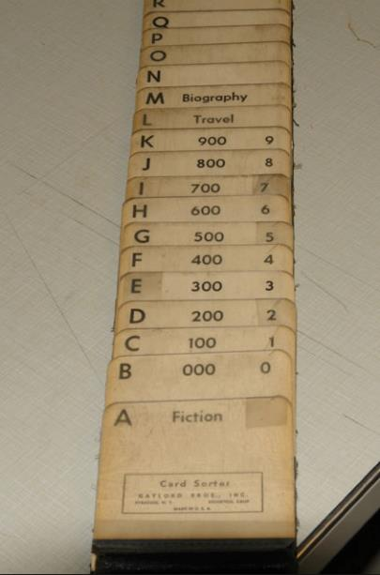
Participation
Tools
While it’s great to see how others are building and sharing open data (and how much of it could be reused), how can libraries and communities of practice participate?
Disclaimer: I’m a member of the RDA Development Team (sponsor of the recent Jane-athon), so I’ll focus on showing you how that data was built

Slide 27
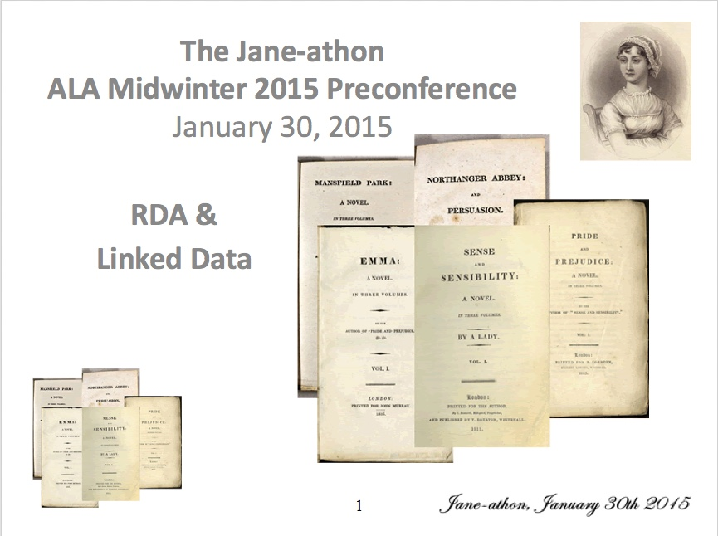
Notes:
Ground-breaking sessions with great feedback, see: http://www.rda-jsc.org/Jane-athon.html for a report and more links. The session was designed to test RDA usefulness in a linked data context, proved that both RDA and RIMMF have what it takes. Some comments included: "Awesome!"; "Like trying to think about time travel"; "We'll need to talk more about relationships and where they belong"; "Cool and fun and nice”.

Slide 28
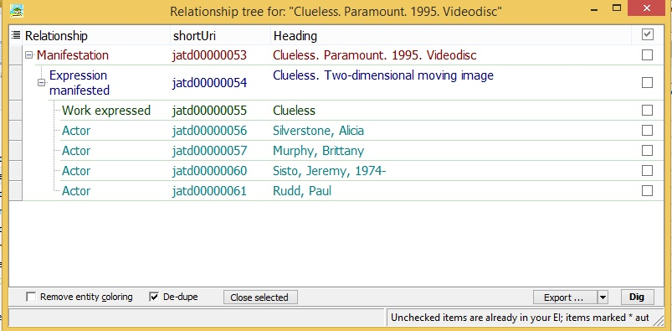
Notes:
This is a screen shot from RIMMF (RDA in Many Metadata Formats) for the movie ‘Clueless’. This view is called an ‘R-Tree’ and is intended to show the structure of a specific resource. Each of the numbers in the middle column is an identifier for a RIMMF description. The parts of the description are based on FRBR packages: Work, Expression, Manifestation (RIMMF doesn’t handle Items at this time)

Slide 29
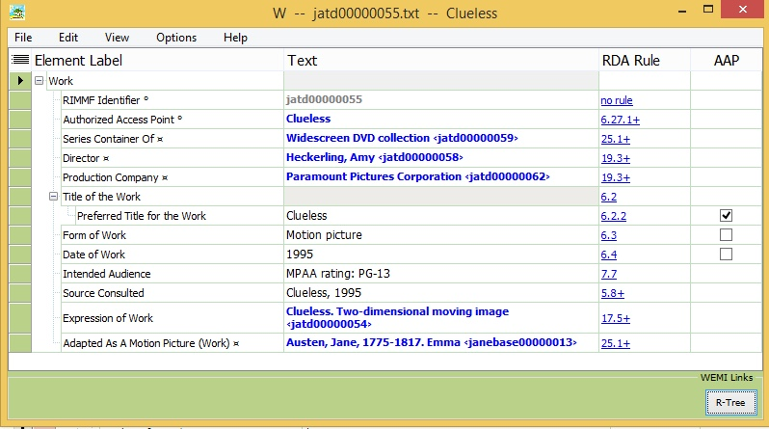
Notes:
This is the work record for the resource. Note the ‘W’ at the top, and the top level ‘Work’ label on the record template. Jane Austen comes in because ‘Clueless’ was adapted from Jane Austen’s ‘Emma’. The RDA Toolkit reference links are in the third column—subscribers can go directly to the applicable instruction.

Slide 30
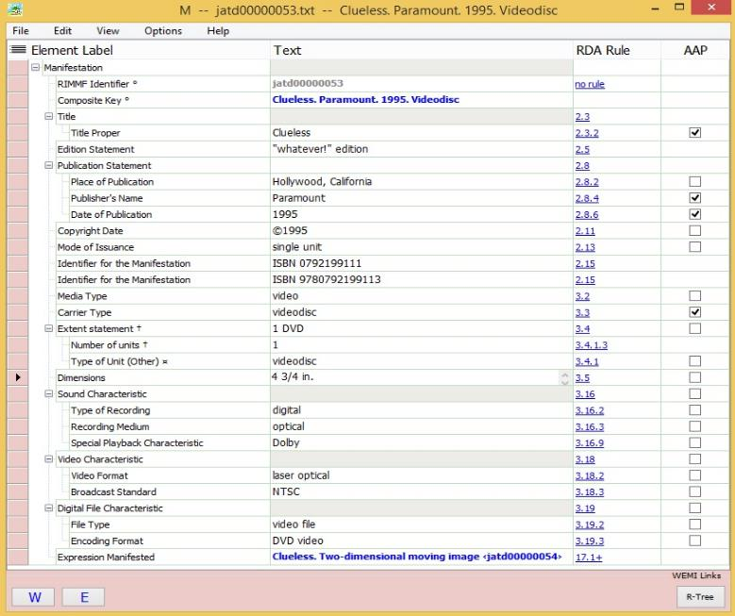
Notes:
The manifestation record, with detailed carrier information for the DVD version used for the description.

Slide 31
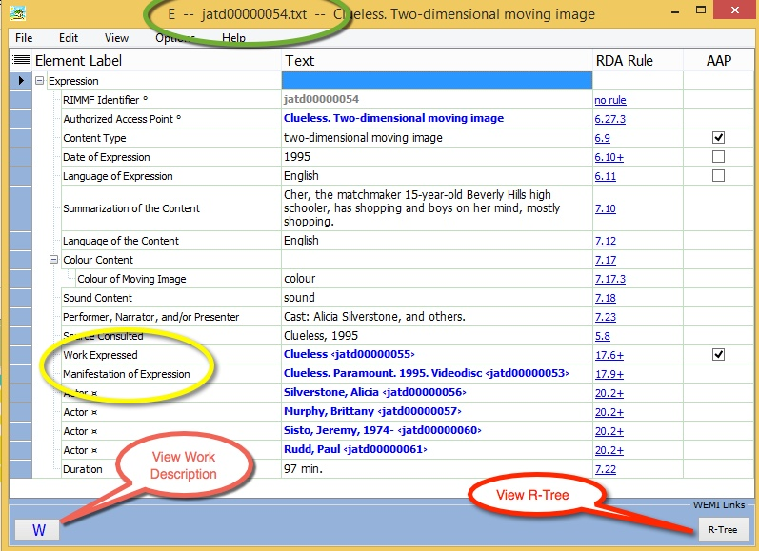
Notes:
The Expression record, showing links to work and manifestation and buttons for the work and the R-tree. Here is where the actors are listed (with RIMMF IDs)

Slide 32
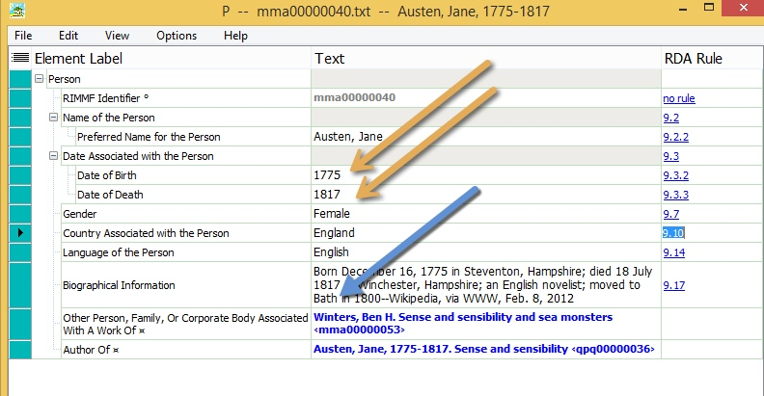
Notes:
This is the RIMMF person description for Jane Austen, including birth and death dates and information on where she lived and died. Also are gathered other people associated with her via her works including another derivative work: “Sense and sensibility and sea monsters”. Also see bio information which describes her relationship with Bath.

Slide 33
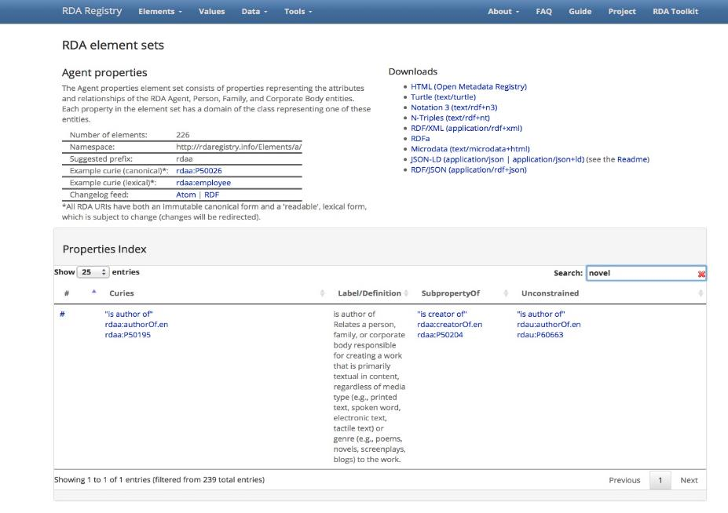
Notes:
Where does RIMMF get the structural data it uses to build data within the application? Here’s the RDA Registry, which manages and maintains the element sets and value vocabularies behind RIMMF (and RDA in general). This index shows the property “isAuthorOf” used to link Jane to her novels and other works. This display (fairly human friendly) shows the element relationships with more general elements as well as the unconstrained version that allows use of RDA without FRBR. These explicit relationships effectively support semantic mapping. Note the download formats on the upper right for applications and other technical users.

Slide 34
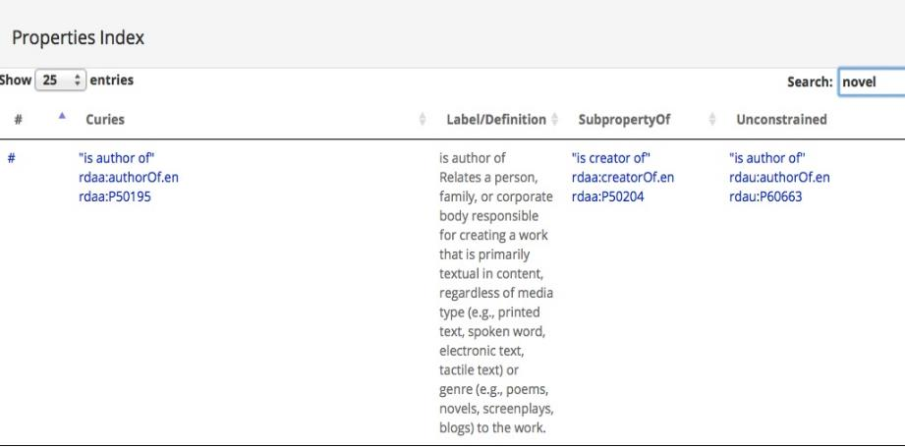
RDA Registry For Property Details
Notes:
Note directionality and that this relates author to work; work to author would be under hasAuthor. Note differences in definition from toolkit—the Registry definition uses ‘Relates’ to show that this property is used as a Predicate.

Slide 35
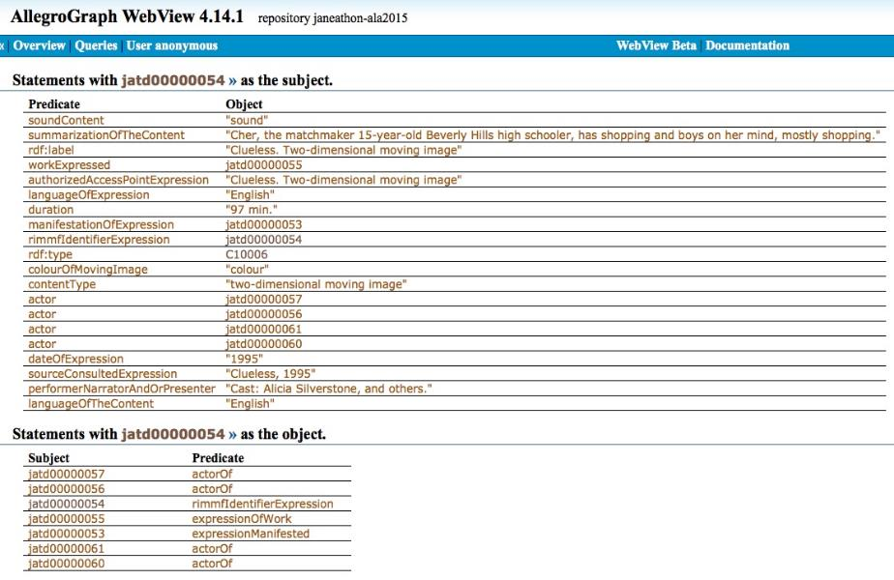
Notes:
This is a simple view of the Expression level data shown in RIMMF on a prior slide, as it appears in the Triple Store (essentially a repository) set up for the Jane-athon. The first table includes statements with the Expression ID as the subject—the two columns in the table show the predicate and object for those Not intended for a user display (unless the user is a tech savvy cataloger!)

Slide 36
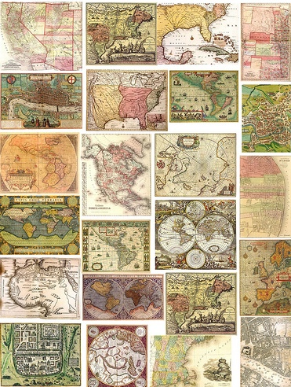
Mapping Our Way Around
-There’s not just one way to align bibliographic data: we don’t have to agree on one ‘authoritative’ mapping
-‘Crosswalking’ strategies, aimed at use by particular applications, are seen as primarily a network activity
-Crosswalks only recognize one relationship: sameAs—a very blunt instrument!

Slide 37
What We Mean by ‘Mapping’
dct:format
dc:format
dct:extent
unim:U215__a
m21:M300
rdam:extent
rdau:extent
rdau:duration
m21:M306__a
rdam:extentOfText
rdau:extentOfText
rdae:duration
isbd:”has extent”
bibo:numVolumes
bibo:numPages
unim:U127__a
Notes:
This is a graphic illustration about how Semantic Mapping works. You’re seeing elements from several bibliographic schemas: Lavender group in upper right is Dublin Core; Peach groups are RDA, some constrained (e, m) some unconstrained (u); Darker tan on bottom level and middle: a variety of schemas: BIBO, UniMARC, MARC 21.
The dotted lines indicate mapping relationships that could be made but are not yet formally available. The undotted lines indicate existing mapping relationships.

Slide 38
Will This Shift Cost Too Much?
Not Necessarily!
Our current investments have reached the end of their usefulness
  All the possible efficiencies for traditional cataloging have already been accomplished (and the goalposts have shifted considerably)
We need to support efforts to invest in more distributed innovation and focused collaboration—sharing the costs
It’s the human effort that costs us most
  Cost of traditional cataloging is far too high, for increasingly dubious value
Quality is not tied to any particular creation strategy
  Human created metadata can be extremely variable
  Machine-created metadata is far more consistent, but that consistency may not be correct
Notes:
Library administrators are reading (?) but too often denying the many studies that indicate that users are NOT USING CATALOGS, in any form (including mobile-enabled ones). The very real costs of retraining and trying to enable the newer ways of providing data outside the silo can’t be compared effectively with doing things the same old way—the path of ‘no change’ is not viable.

Slide 39
Strategic Imperatives
Our big investment is (and has always been) in our data, not our systems
Looking at new descriptive standards, recognize that you still have multiple needs
Beware of experts who promote a ‘one standard’ solution
  For data creation—likely to need richer data for your institution or community
  Distribution can include multiple streams with choices made by downstream user
  There are multiple paths to Linked Open Data; putting all your eggs in one basket will make your institution more vulnerable, not less
Notes:
Choosing one ‘solution’ is not more expensive—the standards themselves are generally available for free (except the RDA Toolkit, at present). There are still questions about how to support innovation, tool development and deployment, as well as sharing.

Slide 40
Notes on Planning
Keep in mind that ‘crosswalks’ are outdated (and provide only one relationship: sameAs)
  Semantic maps are flexible, shareable, and use a variety of relationships
  Support for building and sharing semantic maps is being planned
As you plan: talk to systems people about data flow; your ILS may last for a while longer if you position it as part of your data flow, not your only or primary data flow
Investing in staff education is money well spent—before decisions are made, not after
Notes:
For the last bullet, a caveat against decisions made at the upper administrative levels without the possibility of buy in or consensus from others.

Slide 41
“In the big picture, very little will change: libraries will need to be in the data business to help people find things. In the close-up view, everything is changing-- the materials and players are different, the machines are different, and the technologies can do things that were hard to imagine even 20 years ago.”
Eric Hellman
http://go-to-hellman.blogspot.com/2011/07/library-data-why-bother.html
Notes:
Eric Hellman is the founder and president of Gluejar, a company dedicated to helping authors and publishers sustainably release free ebooks under Creative Commons licenses.

Slide 42
Additional Resources
Rick Anderson, The Crisis in Research Librarianship, Journal of Academic Librarianship, July 2011 http://content.lib.utah.edu/cdm/ref/collection/uspace/id/1467
Introducing Linked Data and The Semantic Web http://www.linkeddatatools.com/semantic-web-basics
Free Your Metadata http://freeyourmetadata.org/
Linked Open Data Laundromat http://lodlaundromat.org
Linked data for libraries, archives and museums : how to clean, link and publish your metadata. Chicago : Neal-Schuman, 2014
Linked data: what cataloguers need to know http://www.cilip.org.uk/cataloguing-indexing-group/presentations/linked-data-what-cataloguers-need-know-2015

Slide 43
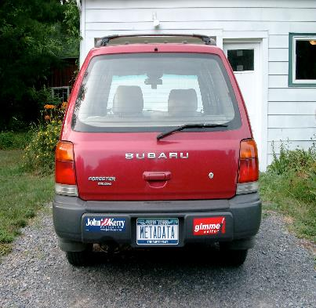
Contact Information
Diane Hillmann
metadata.maven@gmail.com
Links:
http://RDARegistry.info
http://rballs.info
http://marc21rdf.info
http://managemetadata.com/blog/
The First MetadataMobile
(now driving MetadataMobile 2.0)

